Slide 1

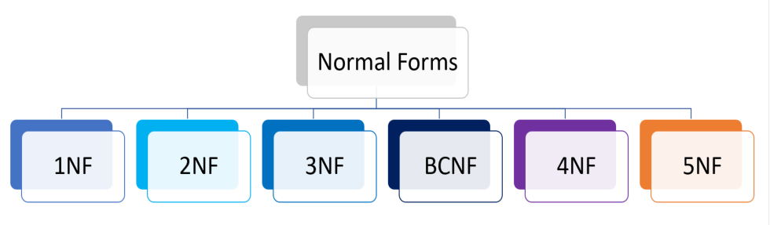
Database Management Systems (BCSC-1003)
Topic: Normalization

Slide 2

Normalization
Normalization is a database design technique that reduces data redundancy and eliminates undesirable characteristics like Insertion, Update and Deletion Anomalies.
Normalization rules divides larger tables into smaller tables and links them using relationships.
The purpose of Normalization in SQL is to eliminate redundant (repetitive) data and ensure data is stored logically.

Slide 3
Anomalies
Anomalies are problems that can occur in poorly planned, un-normalized databases where all the data is stored in one table.
Types of Anomalies:
Insert Anomaly,
Update Anomaly, and
Delete Anomaly.

Slide 4
Anomalies
Insertion Anomaly:
An Insert Anomaly occurs when certain attributes cannot be inserted into the database without the presence of other attributes.
Update or Modification Anomaly:
An update anomaly is a data inconsistency that results from data redundancy and a partial update.
Deletion Anomaly:
A deletion anomaly occurs when you delete a record that may contain attributes that shouldn't be deleted.

Slide 5
Anomalies
SRNO | SNAME | CREDIT | DEPT_NAME | BUILDING | ROOM_NO
1 | Rahul | 5 | CSE | B1 | 101
2 | Jitendra | 8 | CSE | B1 | 101
3 | Jagdish | 9 | EE | B2 | 201
4 | Payal | 7 | EE | B2 | 201
5 | Ankur | 9 | CIVIL | B1 | 110
6 | Akash | 8 | ECE | B1 | 115
7 | Vansh | 7 | CIVIL | B1 | 110
8 | Tanuj | 6 | CSE | B1 | 101

Slide 6
Insert Anomalies
SRNO | SNAME | CREDIT | DEPT_NAME | BUILDING | ROOM_NO
1 | Rahul | 5 | CSE | B1 | 101
2 | Jitendra | 8 | CSE | B1 | 101
3 | Jagdish | 9 | EE | B2 | 201
4 | Payal | 7 | EE | B2 | 201
5 | Ankur | 9 | CIVIL | B1 | 110
6 | Akash | 8 | ECE | B1 | 115
7 | Vansh | 7 | CIVIL | B1 | 110
8 | Tanuj | 6 | CSE | B1 | 101
- | - | - | ME | B1 | 120

Slide 7
Update Anomalies
SRNO | SNAME | CREDIT | DEPT_NAME | BUILDING | ROOM_NO
1 | Rahul | 5 | CSE | B1 B4 | 101 301
2 | Jitendra | 8 | CSE | B1 B4 | 101 301
3 | Jagdish | 9 | EE | B2 | 201
4 | Payal | 7 | EE | B2 | 201
5 | Ankur | 9 | CIVIL | B1 | 110
6 | Akash | 8 | ECE | B3 | 115
7 | Vansh | 7 | CIVIL | B1 | 110
8 | Tanuj | 6 | CSE | B1 B4 | 101 301

Slide 8
Delete Anomalies
SRNO | SNAME | CREDIT | DEPT_NAME | BUILDING | ROOM_NO
1 | Rahul | 5 | CSE | B1 | 101
2 | Jitendra | 8 | CSE | B1 | 101
3 | Jagdish | 9 | EE | B2 | 201
4 | Payal | 7 | EE | B2 | 201
5 | Ankur | 9 | CIVIL | B1 | 110
6 | Akash | 8 | ECE | B1 | 115
7 | Vansh | 7 | CIVIL | B1 | 110
8 | Tanuj | 6 | CSE | B1 | 101

Slide 9
Solution
STUDENT DEPARTMENT
SRNO | SNAME | CREDIT | DEPT_NAME
1 | Rahul | 5 | CSE
2 | Jitendra | 8 | CSE
3 | Jagdish | 9 | EE
4 | Payal | 7 | EE
5 | Ankur | 9 | CIVIL
6 | Akash | 8 | ECE
7 | Vansh | 7 | CIVIL
8 | Tanuj | 6 | CSE
DEPT_NAME | BUILDING | ROOM_NO
CSE | B4 | 301
EE | B2 | 201
CIVIL | B1 | 110
ECE | B1 | 115

Slide 10
Advantages of Normalization
Following are some of the advantages of normalization:
1.To reduce the redundancy from the table.
2. To save the memory space as data can be stored in compact form.
3. To remove Insert, Update and Delete anomalies.
4. Normalization minimizes the null values.
5. Using normalization, we can simple the queries.
6. It is important for OLTP (Online Transaction Processing). However De-normalization supports OLAP (Online Analytical Processing).
7. It simplifies the database structure.
8. Searching, sorting and creating indexes will be faster after applying the normalization.

Slide 11
References
Korth, Silbertz and Sudarshan (1998), “Database Concepts”, 4th Edition, TMH.
Elmasri and Navathe (2010), “Fundamentals of Database Systems”, 5th Edition, Addision Wesley.
Date C J,” An Introduction to Database Systems”, 8th Edition, Addision Wesley.
M. Tamer Oezsu, Patrick Valduriez (2011). “Principles of Distributed Database Systems”, 2nd Edition, Prentice Hall.

Slide 12


